Slide 1

Ref is out
Lecturer
Roka Slaboševičius
Data

Slide 2
Today you will learn
Ref is out
Ref
01
Out
02

Slide 3
What is the ref keyword?
Ref is out
The ref keyword is used in C# to pass a variable as a reference to a method rather than as a value. When a variable is passed as a reference, it means that any changes made to the variable inside the method will be reflected in the external variable. That is, if the value of a variable inside a method is changed, the original variable outside the method will also be changed.

Slide 4
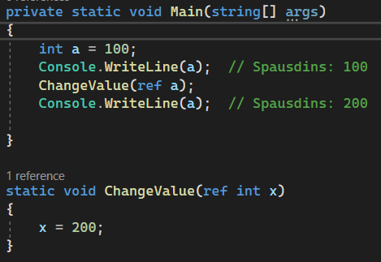
What is the ref keyword?
Ref is out
Simply put, ref allows us to change the values of variables within a method.
Here's a simple example of how we can use ref:
Here, we have the ChangeValue method,
which accepts a variable of type int as a reference (via the ref keyword).
In the ChangeValue method we change the value of the variable x to 200.
Since x is passed as a reference, this change is reflected in
and in variable a, outside the ChangeValue method.
Therefore, by typing a after the ChangeValue method
call, we see a new value of 200 instead of the original value of 100.
It is very important to understand that ref requires that the variable
be pre-initialised before being passed as a method reference.

Slide 5
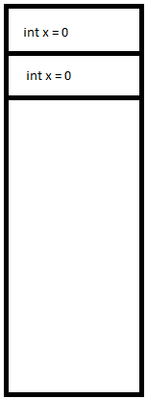
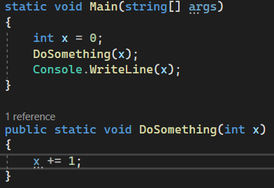
Why is this happening?
Ref is out
The program stores variables in memory, for each variable
by allocating the right amount of memory, these variables will "live"
in memory until their scope expires (at this point, it's enough to understand,
that scope is the method where the variable was created).
So if we pass a variable as a parameter to another method,
a new variable is created and extracted(allocation)
a new place in memory.

Slide 6
Why is this happening?
Ref is out
As a consequence, if we change the value of variable x in DoSomething(), the original value that we passed to main does not change because, as we can see, a completely different variable is created in memory, which simply has the same value.
If you are wondering how the program chooses which x variable to use, "under the hood" variables have addresses, like apartments or houses.

Slide 7
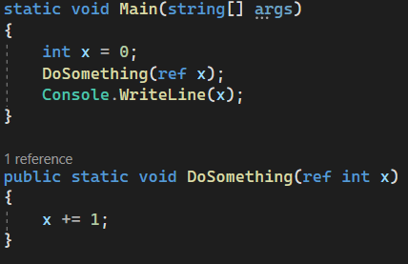
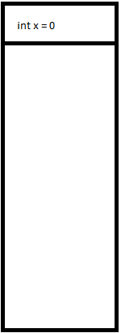


Why is this happening?
Ref is out
However, if we describe a method with the ref keyword, we are saying that we will not pass a value to this method, but the original variable, in other words, we will pass the address in memory of the original variable.

Slide 8

Out and ref
Task 1
Create a Swap method that swaps the values of two variables of type int. These variables must be passed as a reference (ref).
Create an IncrementByN method that takes a variable of type int as a reference (ref) and increments its value by the specified number.
Create a method TrimAndCapitalize that accepts a variable of type string as a reference (ref). The method must remove the leading and trailing spaces (if any) from the string and make the first letter of the string uppercase.

Slide 9
What is out?
Ref is out
The out keyword is a special feature of the C# language used for parameters that will be given the value captured in the method. Unlike the ref keyword, the out parameter does not require an initial value before passing it to the function. All that needs to be done is to declare the variable before passing it as an out parameter.

Slide 10
What is out?
Ref is out
Depending on the situation, the out keyword can be useful in different situations:
When functions need to return more than one value.
When you want a function to assign a value to a variable whose initial value is irrelevant.
Security:
It should also be mentioned that a function using the out parameter must assign a value to this parameter before exiting the function. In other words, functions that use out parameters must guarantee that the out parameter will be initialized.

Slide 11
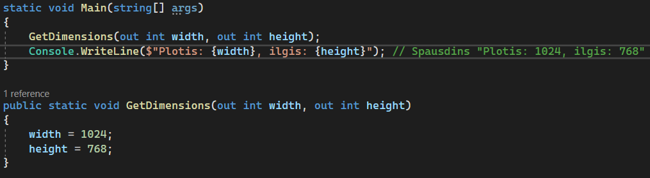
What is out?
Ref is out
What is worth noting is that the width and height variables passed with the out keyword are created and passed at the same time.
As you can see above the GetDimensions() method they are not declared, but after the GetDimensions() method they are
used for printing.

Slide 12
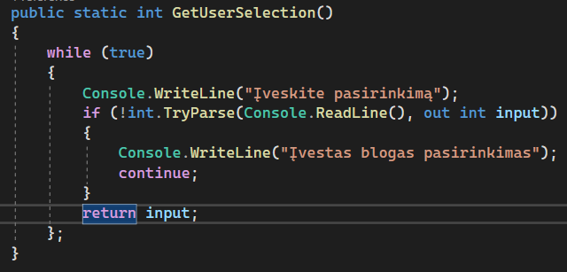
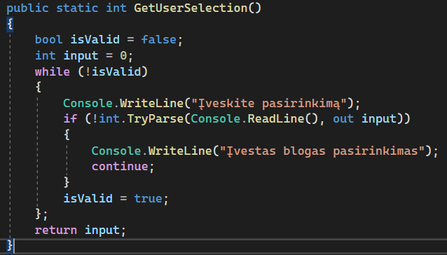
What is out?
Ref is out
Here are two real-life applications of out.
A two-way modified method from
one of our lectures.
The first method using while(true) may appear
simpler, but better avoided because there is no direct variable
to control the cycle.
In the second example, the loop is controlled by the variable isValid.

Slide 13
Out and ref
Task 2
Create a GetUserData method that accepts two variables of type string (out): first name and last name. The method must read the user's first and last name from the console, then return them via the out parameters.
Create a while loop that continues until the user enters a number greater than 100. In the loop, use the TryParse method, which returns two values: whether the conversion of the input to a number (a variable of type bool) was successful, and the number itself (if the conversion was successful). This method uses the out parameter to return the number.
Create a Divide method that accepts two numbers of type double and performs division. The method should return the quotient as the result and the remainder via the out parameter. The method must be safe, i.e. if an attempt is made to divide by zero, the method returns false and does not evaluate the quotient and remainder.

